Slide 1


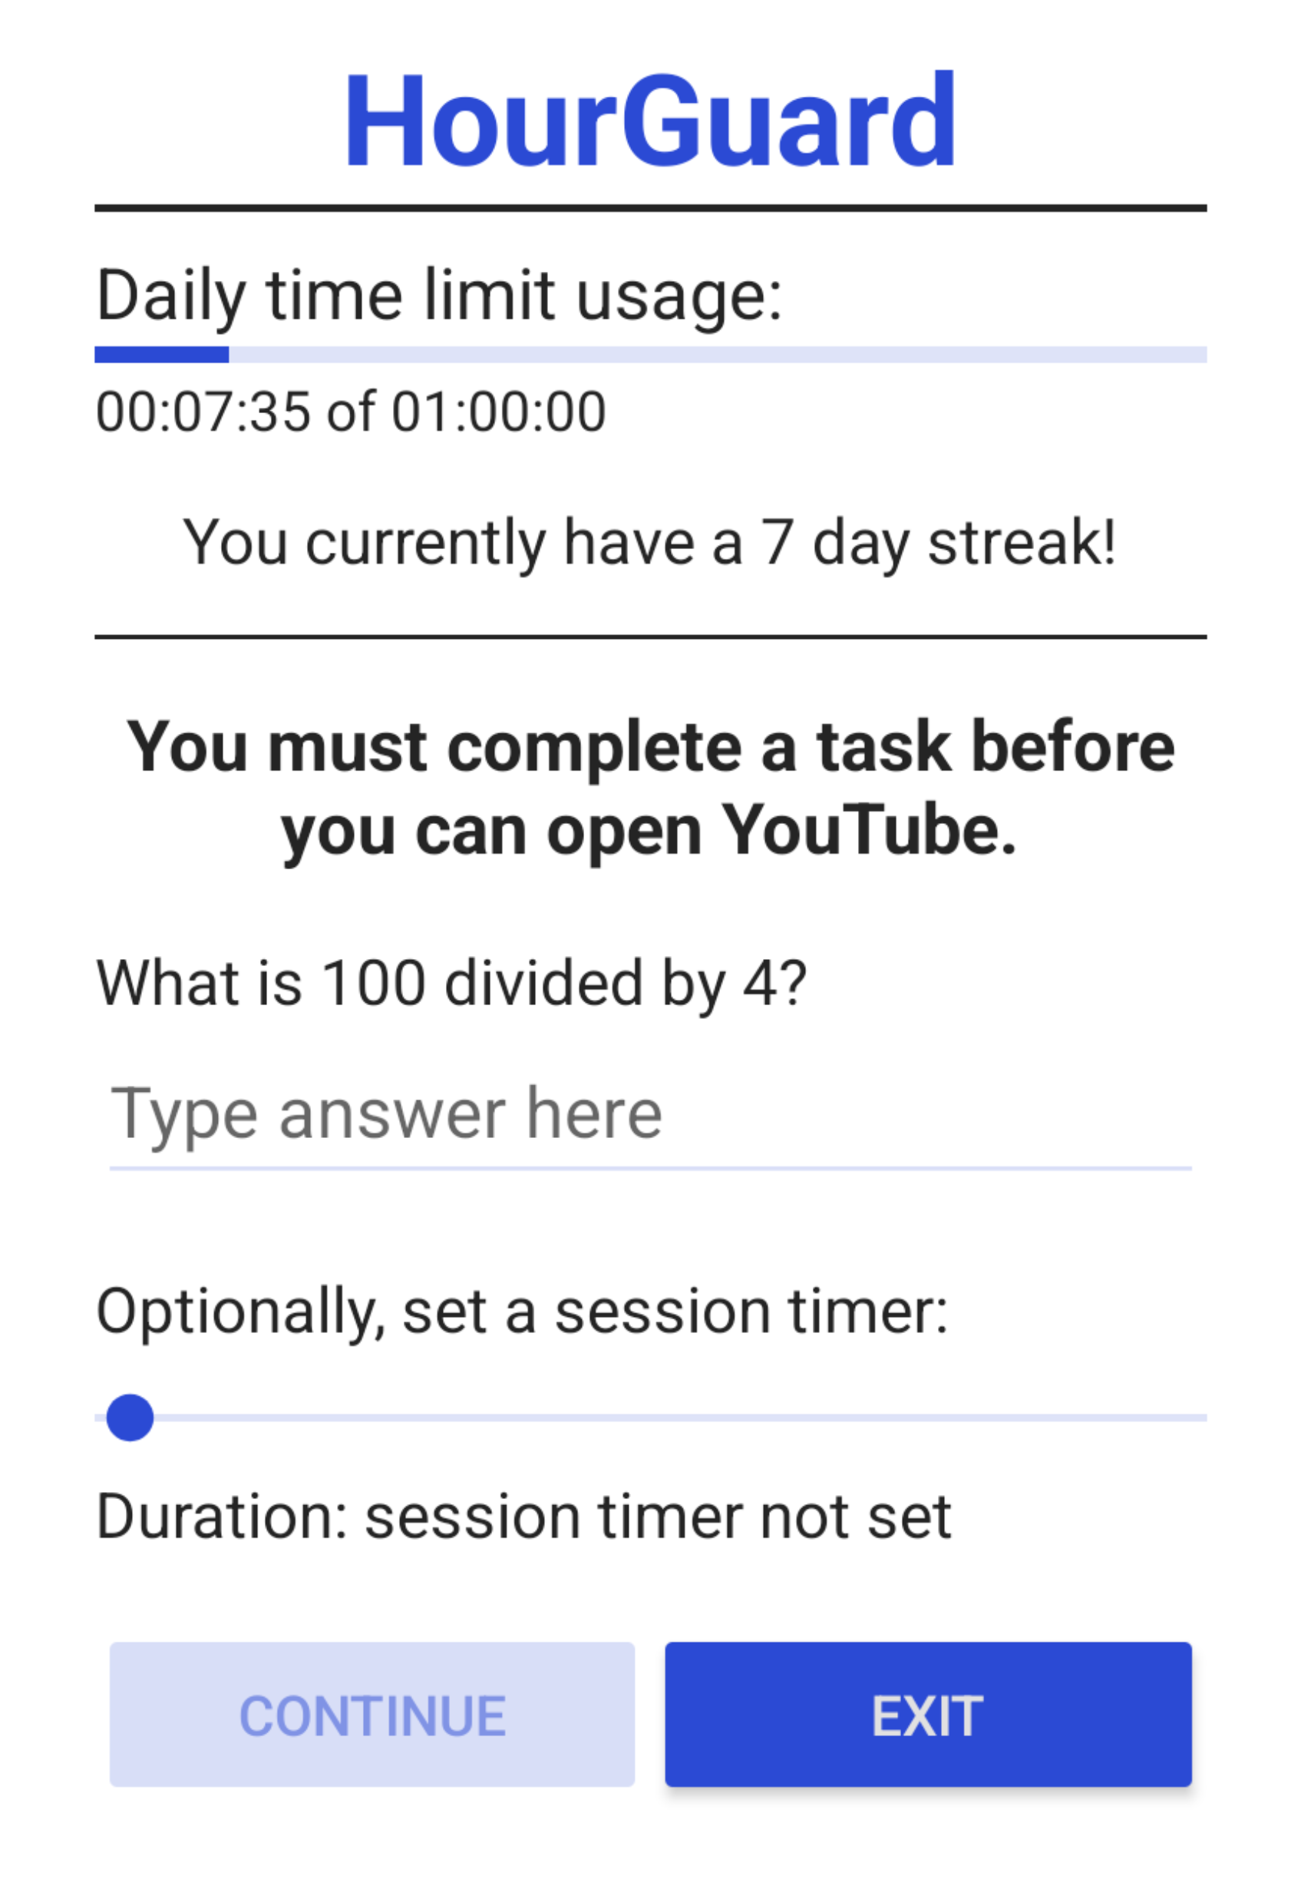
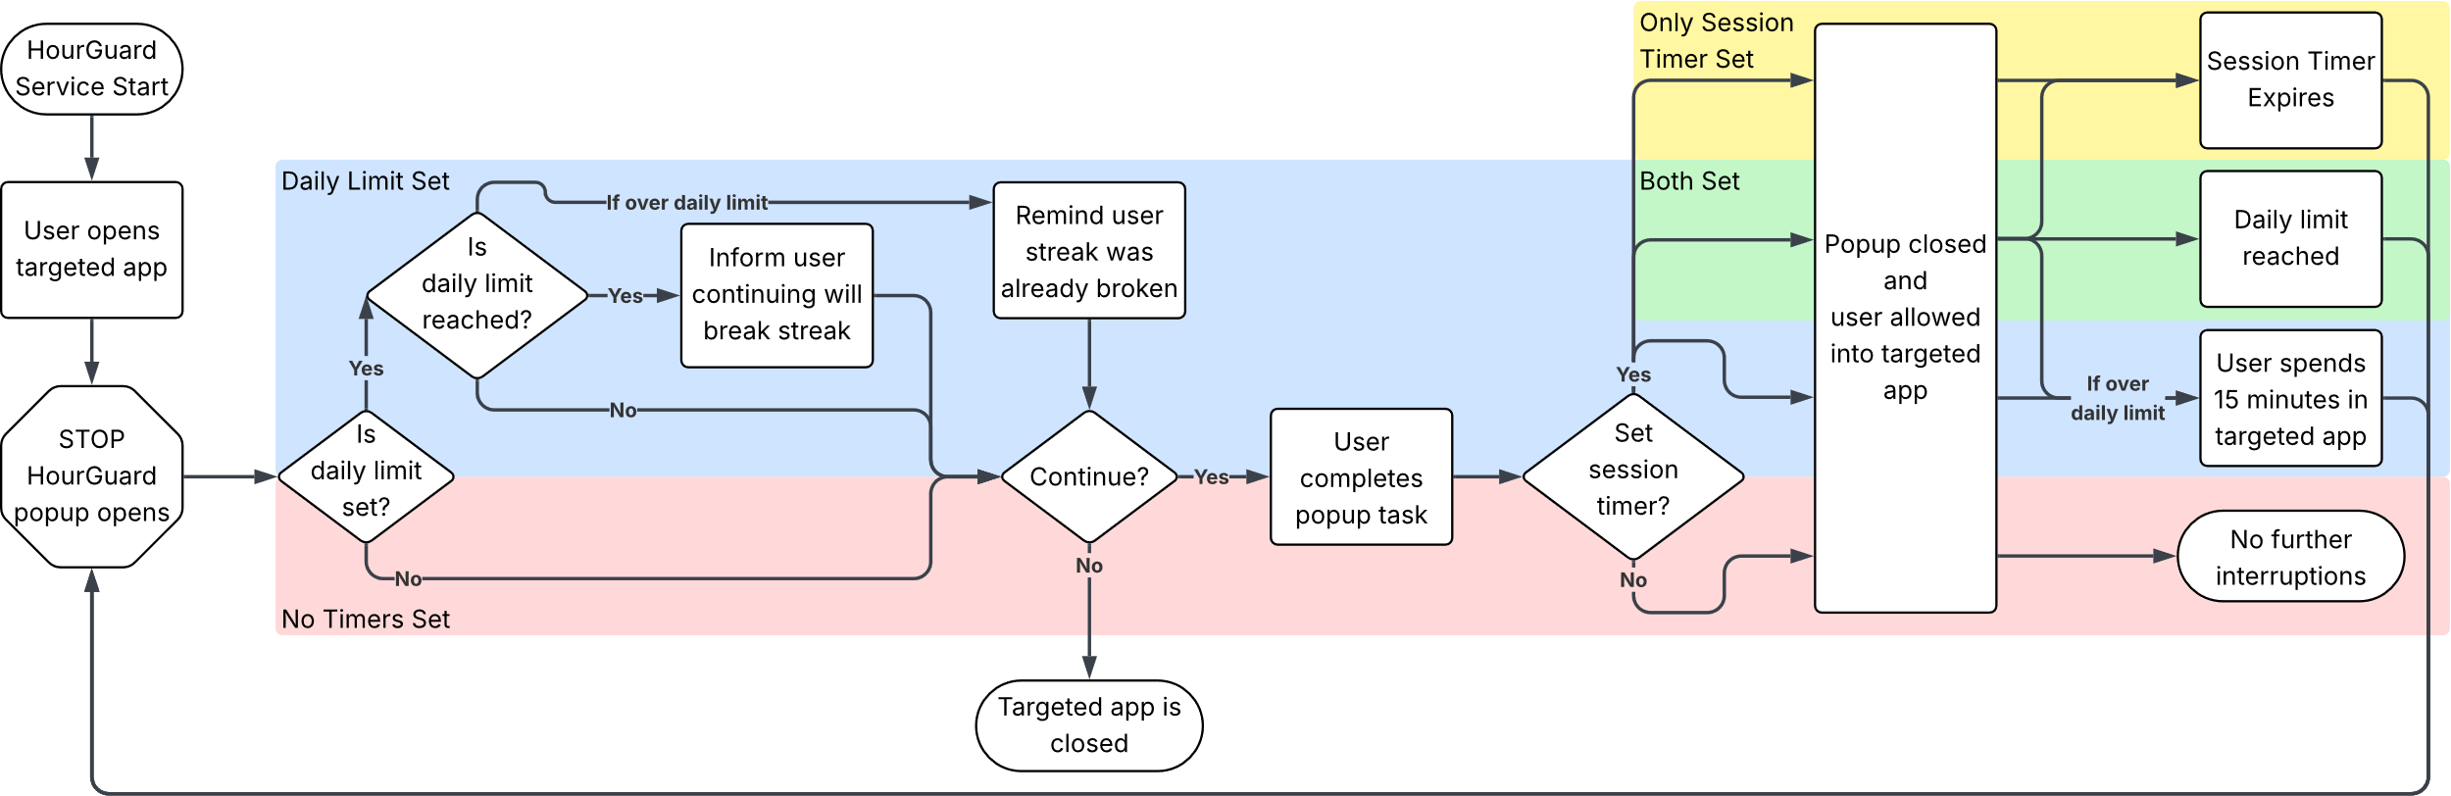



Team 4: Nicholas Dumford, Bobby Fechtel, Chase Smith
Advisor: Dr. Shane Halse
College of Education, Criminal Justice, and Human Services
HourGuard
The Problem
Our Solution
Cell phones are distracting and constantly begging for attention
Social media apps are especially addicting, designed to keep you on them as long as possible
Current solutions are primarily designed for parents
HourGuard Popup
Flexible app limits
Set daily limits, per-session timers, or both
Prevents negative habituation
Thoughtful deterrence task prevents mindlessly opening apps
Track progress
Per-app streaks provide positive reinforcement
Screenshot?
About HourGuard
HourGuard is a psychology-backed time management app for Android
Helps the user build healthy screen time habits
Designed for the user
How it Works
Activity Diagram
Technologies

